Slide 1


Reusing Discriminators for Encoding:
Towards Unsupervised Image-to-Image Translation
胡晟 陈伟杰 2020.04.30

Slide 2
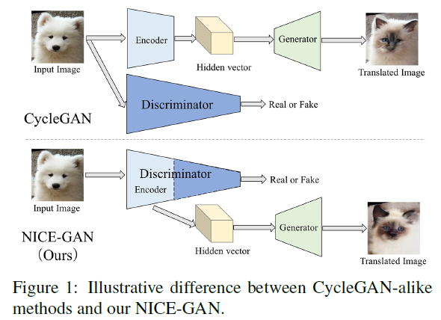
NICE-GAN: No-Independent-Component-for-Encoding GAN

Slide 3
NICE-GAN: No-Independent-Component-for-Encoding GAN
Three contributions:
Reuse discriminators for encoding for unsupervised image-to-image translation.
Develops a decoupled training paradigm.
Extensive experimental evaluations on several popular benchmarks.

Slide 4
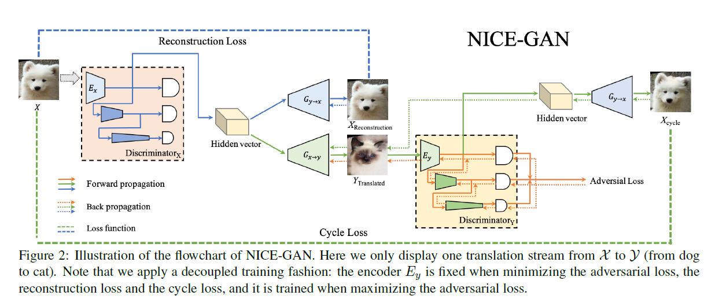
NICE-GAN: Full objective

Slide 5
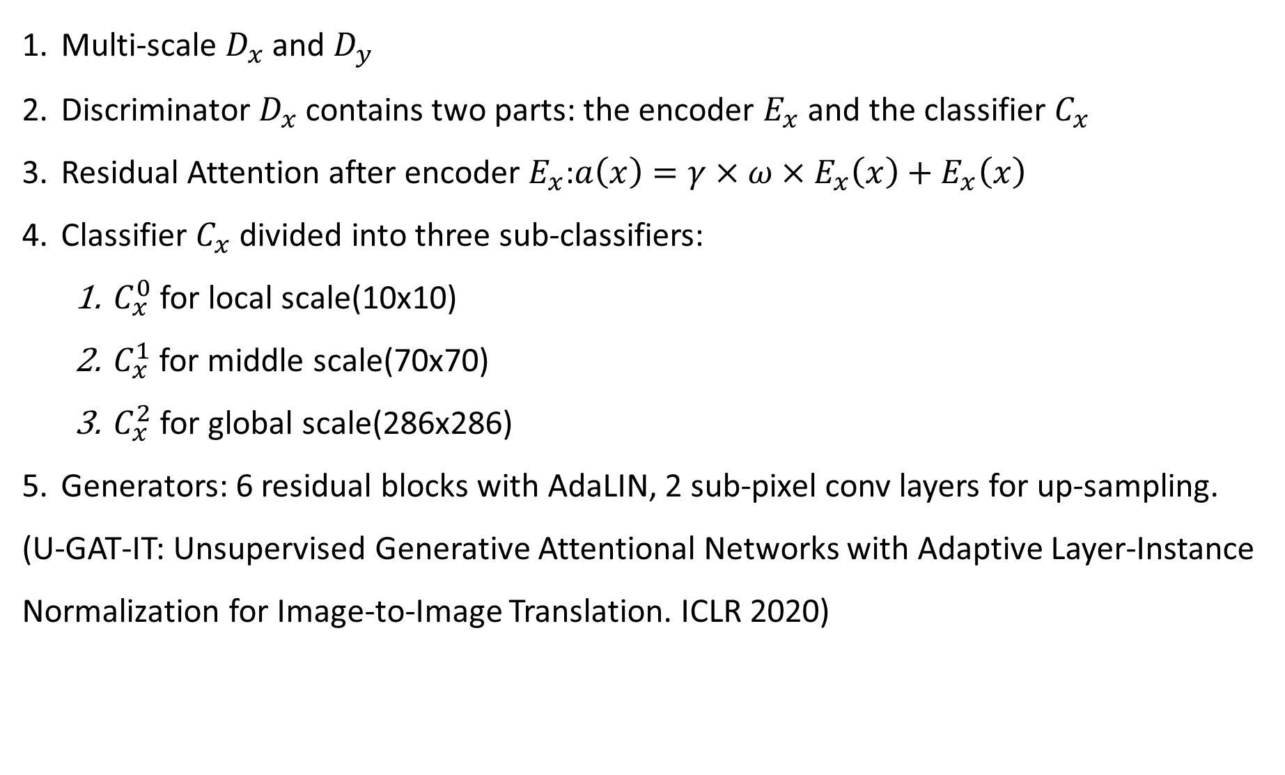
NICE-GAN: Architecture
Multi-scale $D_{x}$ and $D_{y}$
Discriminator $D_{x}$ contains two parts: the encoder $E_{x}$ and the classifier $C_{x}$
Residual Attention after encoder $E_{x}$:$a\left(x\right)=γ×ω×E_{x}\left(x\right)+E_{x}\left(x\right)$
Classifier $C_{x}$ divided into three sub-classifiers:
$C_{x}^{0}$for local scale(10x10)
$C_{x}^{1}$ for middle scale(70x70)
$C_{x}^{2}$ for global scale(286x286)
Generators: 6 residual blocks with AdaLIN, 2 sub-pixel conv layers for up-sampling.
(U-GAT-IT: Unsupervised Generative Attentional Networks with Adaptive Layer-Instance Normalization for Image-to-Image Translation. ICLR 2020)

Slide 6
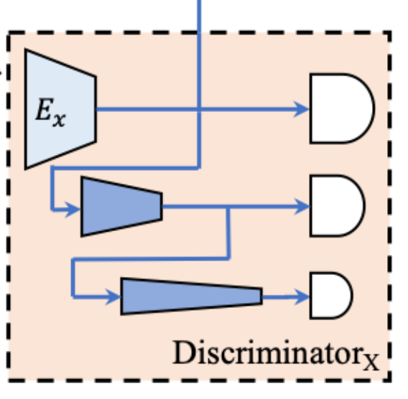
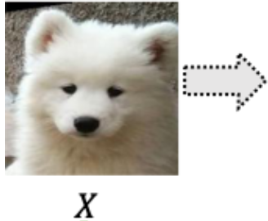
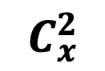
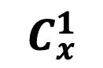
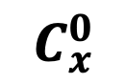
Hidden Vector z
Discriminator Architecture
FC.parameter
FC
$$C_{x}^{0}$$
pool
conv2d
$$C_{x}^{1}$$
conv2d
$$C_{x}^{2}$$

Slide 7
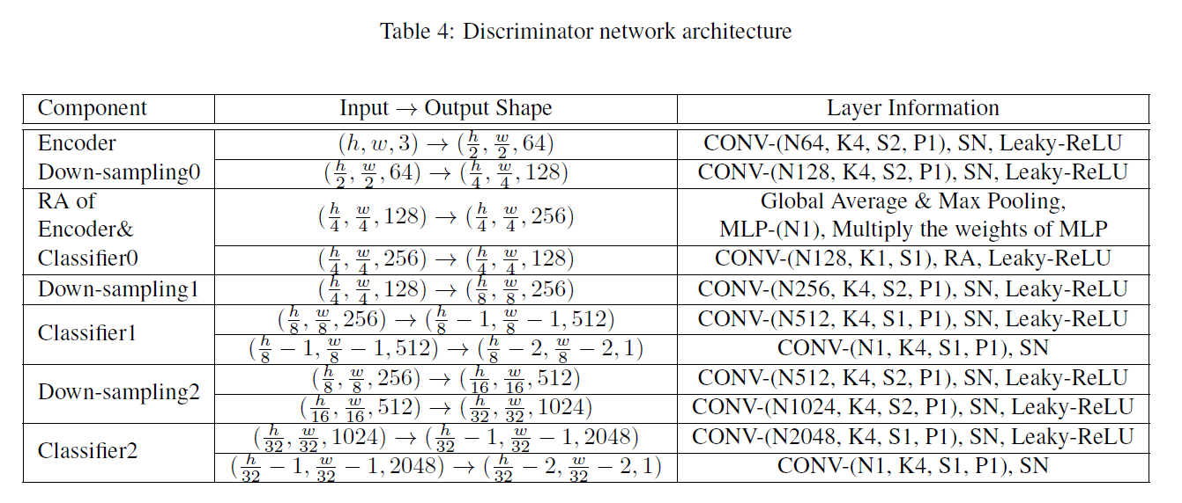
NICE-GAN: Architecture
Generator

Slide 8
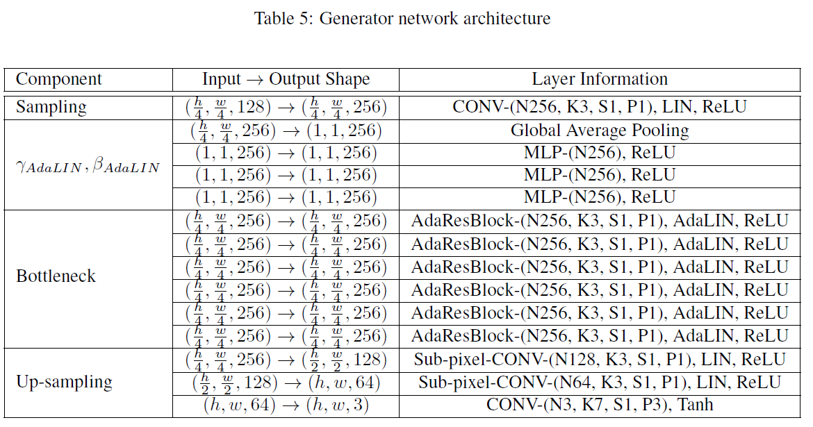
NICE-GAN: Architecture
AdaLIN: adaptive layer-instance normalization. U-GAT-IT: Unsupervised Generative Attentional Networks with Adaptive Layer-Instance Normalization for Image-to-Image Translation. ICLR 2020

Slide 9
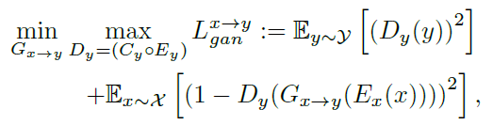
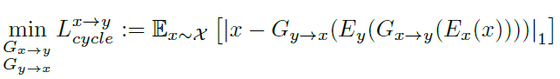
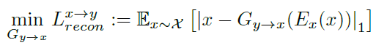
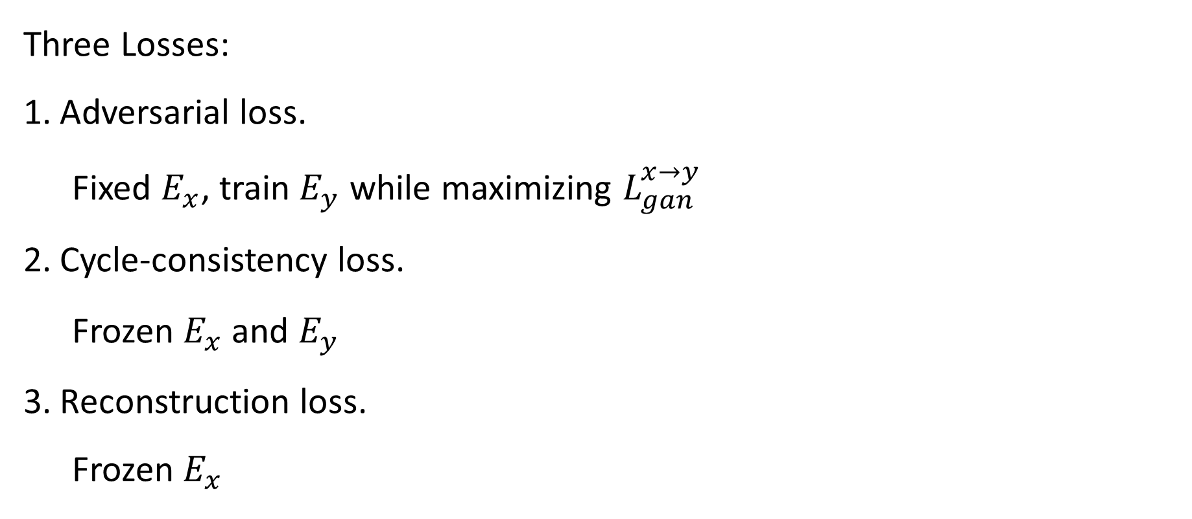
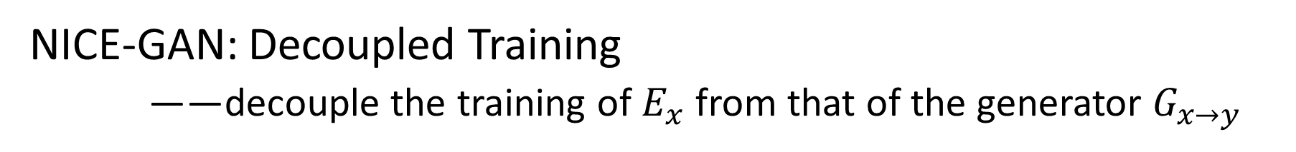
NICE-GAN: Decoupled Training
——decouple the training of $E_{x}$ from that of the generator $G_{x→y}$
Three Losses:
Adversarial loss.
Fixed $E_{x}$, train $E_{y}$ while maximizing $L_{gan}^{x→y}$
Cycle-consistency loss.
Frozen $E_{x}$ and $E_{y}$
Reconstruction loss.
Frozen $E_{x}$

Slide 10
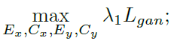
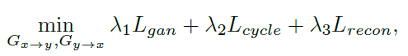
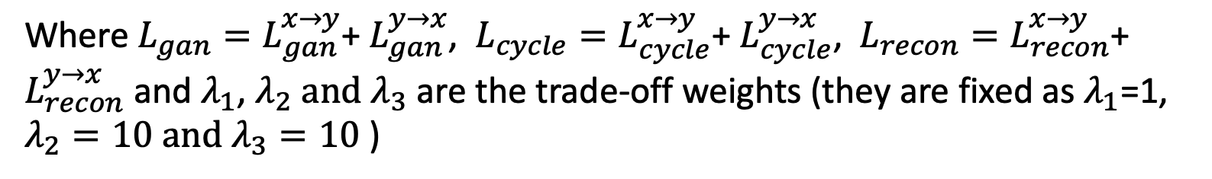
NICE-GAN: Full objective
Discriminators’ final objective:
Generators’ final objective:
Where${ L_{gan}=L}_{gan}^{x→y}$+ $L_{gan}^{y→x}$, ${ L_{cycle}=L}_{cycle}^{x→y}$+ $L_{cycle}^{y→x}$, ${ L_{recon}=L}_{recon}^{x→y}$+ $L_{recon}^{y→x}$ and $λ_{1}$, $λ_{2} and{ λ}_{3}$ are the trade-off weights (they are fixed as $λ_{1}$=1, $λ_{2}=10 and{ λ}_{3}=10$ )

Slide 11
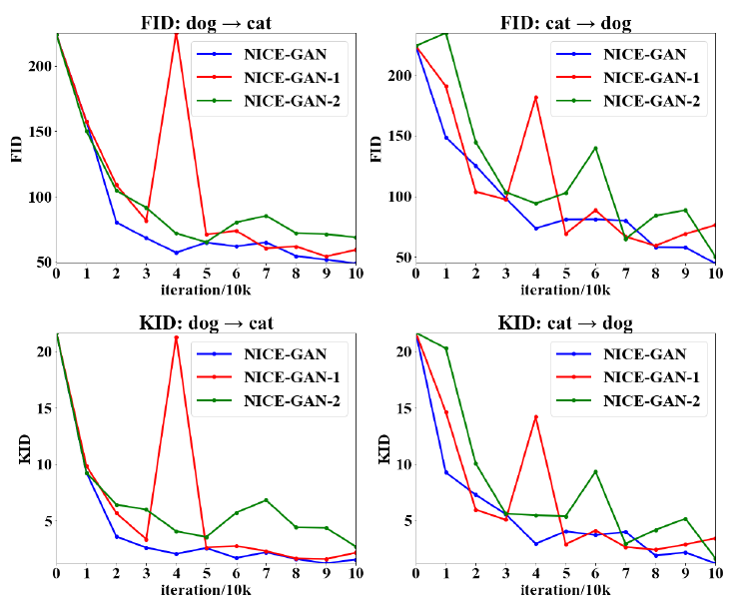
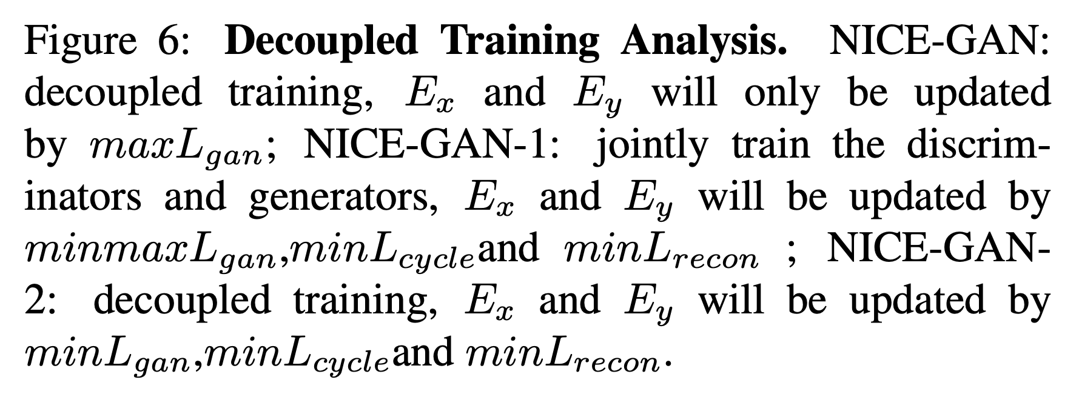
NICE-GAN: Decoupled training experiment
NICE-GAN:
decoupled encode with generators
NICE-GAN-1:
jointly trained with generators and discriminators
NICE-GAN-2:
decoupled encode with discriminators (classifiers)

Slide 12
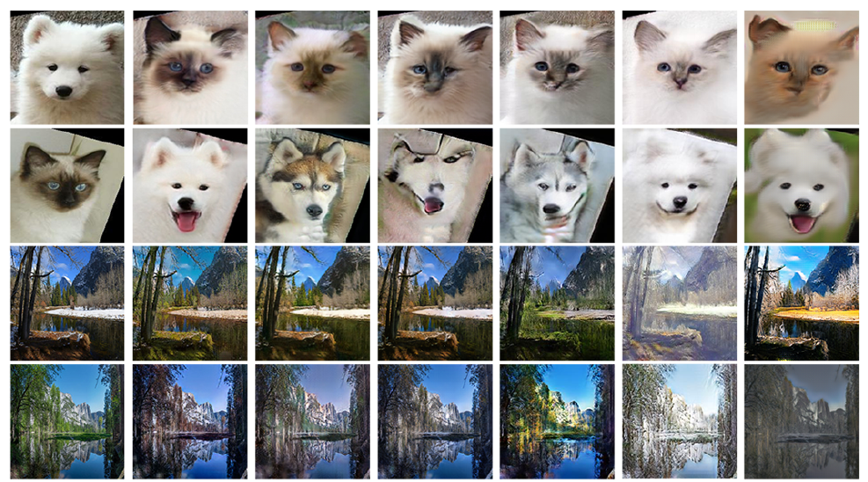
NICE-GAN: Results

Slide 13
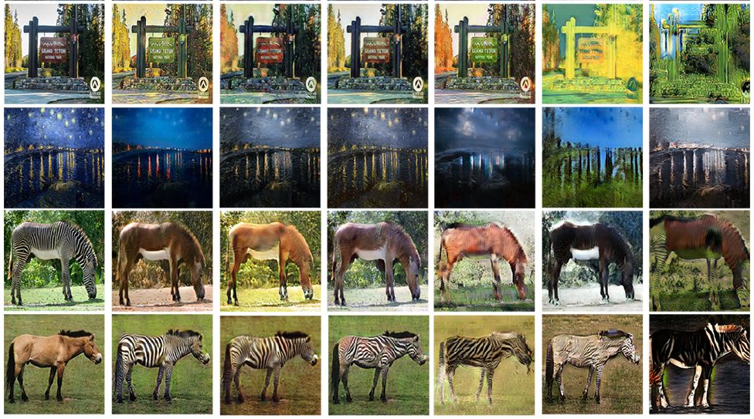
NICE-GAN: Results

Slide 14
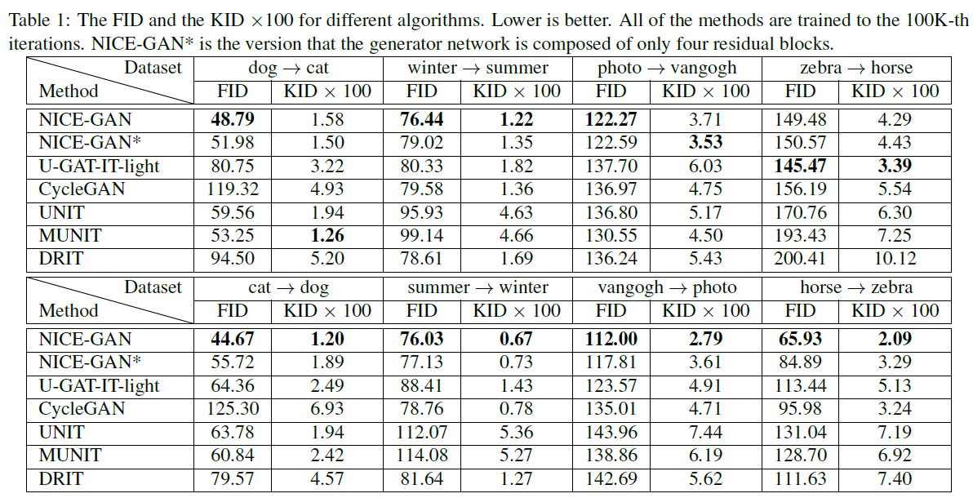
NICE-GAN: Results

